Slide 1
CodeGenie: AI companion for effortless code creation

Slide 2
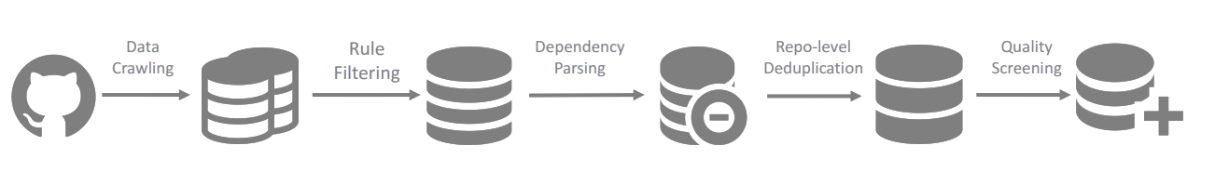
Data Collection
The dataset includes 87 diverse programming languages, sourced from high-quality Repos from GitHub. Filtering and deduplication ensure quality, removing redundant or low-value samples. Ethical considerations minimize bias and sensitive content. The data is balanced across different coding paradigms to improve generalization and enhance real-world applicability.

Slide 3
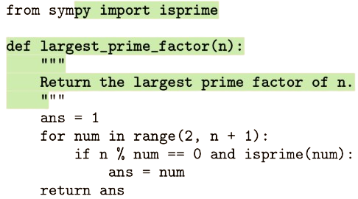
Training
The model employs Next Token Prediction (NTP), where it learns to predict the next token in a sequence, enhancing code completion abilities. Fill-in-the-Middle (FIM) enables code infilling by randomly masking parts of a sequence and training the model to reconstruct missing content, improving context-aware coding.

Slide 4
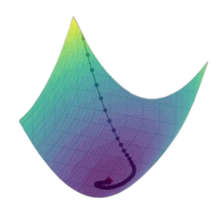
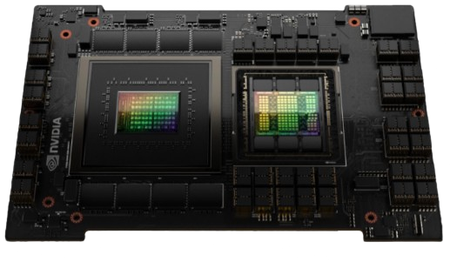
Training
The model is optimized using AdamW with cosine scheduling and warm-up steps. Training occurs on NVIDIA A100 and H800 GPUs with parallelization techniques. The Instruct Model is fine-tuned with high-quality instructions, enabling better task adaptability and improving coding assistance in multi-turn dialogue scenarios.

Slide 5
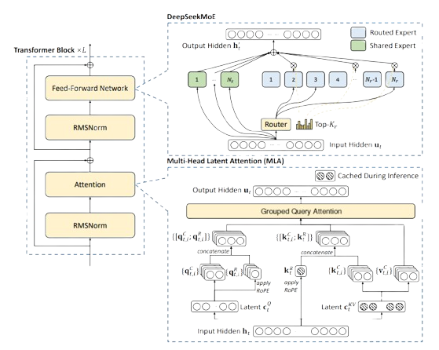
Architecture
The transformer-based model integrates Grouped-Query-attention with RoPE for long-context understanding. Multi-Head Latent Attention (MLA) reduce memory usage, improving efficiency. Layer normalization and residual connections enhance stability. The architecture is optimized for parallelized computation, making it highly scalable for large-scale distributed training.

Slide 6
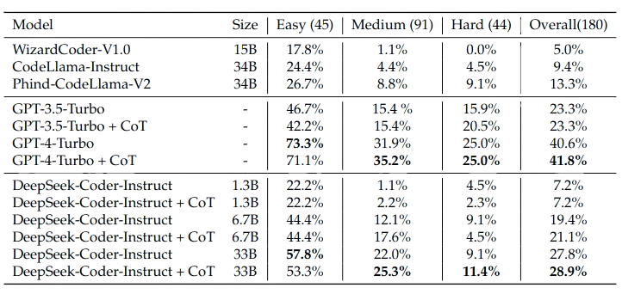
Performance Metrics
The performance of the model can measured by benchmarks like humaneval and MBPP. Computational efficiency is measured by FLOPs per token, inference latency, and memory footprint. The model generalizes across multiple programming languages, outperforming existing models in benchmarks like code completion, function synthesis, and bug detection.

Slide 7

Relevance to our Project
DeepSeek is the most advanced open-source model, surpassing other open-source models by 5 times in performance while efficiently handling large contextual data. Its capabilities make it ideal for various applications, including prompt-based code generation, error correction, and intelligent code suggestions, providing developers with a powerful AI-driven coding assistant.

